Slide 1
Investing crash course
Sean McCormick, MD
Transitions Conference
September 20, 2018

Slide 2
Ballpark Ideas

Slide 3
Disclosures
First time I have ever had anything to disclose
I too am not a professional financial advisor
401K with Fidelity
Roth IRA with Betterment (roboadvisor)
Taxable Investment Account with Charles Schwab
Student Loans refinanced first time with DRB (now Laurel Road)
Student Loans refinanced second time with SoFi

Slide 4
An investment promises safety of principal and an adequate return. Operations not meeting these requirements are speculation.
- Benjamin Graham

Slide 5
5 Asset classes
Stocks
Bonds
Real Estate
Cash
Stuff (everything else)

Slide 6
Annualized rate of return
Expected gain of an asset
How assets are compared
Ignore inflation (for today)= 2-3%/yr
Rule of 72: Divide 72 by annual return to estimate doubling time
Ie if you expect 6% retrun -> 72/6 = 12 yrs to double your money

Slide 7
1. Stocks = equities
Company has many options to raise capital, one of them is to “go public”
Company values its company, divides that number into shares and sells them to people in IPO (Initial Public Offering)
Ie if company worth 3 million and sell shares at $10 each, the whole company is divided into 30,000 shares
Approximately 4000 US stocks
Historical annual return: 7-9%
Risks/Benefits: High return, high risk, good liquidity

Slide 8
Historical data
Dow Jones Industrial Average 1896-2014
Odds of losing money in stock market:
1 yr: 32%
5 yr: 13%
10 yr: 2%
16 yr: Hasn’t happened*
*since 1929 crash
SEC created 1934

Slide 9
Predicting the stock market is like predicting the movements of a dog at a dog park: impossible to predict the exact movements, but very possible to predict starting and ending point.
-John Train

Slide 10
Index funds
Group of stocks that attempts to track the performance of a benchmark
Ie S&P500 index funds tracks the performance of the 500 largest US companies
Larger companies make up a larger proportion of the index fund
Index fund for almost everything
Total stock market, small companies, growth companies, international, etc

Slide 11
2. Bonds = fixed income securities
You loan your money to a company and charge interest
You buy the bond and it pays an interest rate for the term of the bond
Ie if you buy a $1000 bond at 6% for 10 yrs, it will pay you $60/yr x 10 yrs and then you get your $1000 back
Historical annual return: 4-6%
R/B: Low risk, low return, poor liquidity (unless you hold a bond index)

Slide 12
3. Real estate
According to US census, median home price in 2018 is $328,000
Many doctors are landlords, own rental properties
Consider time, money in managing tenants/property or paying someone else to do those things
REITs (Real Estate Investment Trusts) = fund of commercial real estate properties
Historical annual return: 7%
R/B: High return, variable risk, poor liquidity

Slide 13
4. CASH
Money you have at your immediate disposal
Cash equivalents: not cash, but can be easily converted to cash
Like money market funds whose historical annual return: 1%
Historical annual return: 0% (less with inflation)
R/B: No return, NO risk, highest liquidity

Slide 14
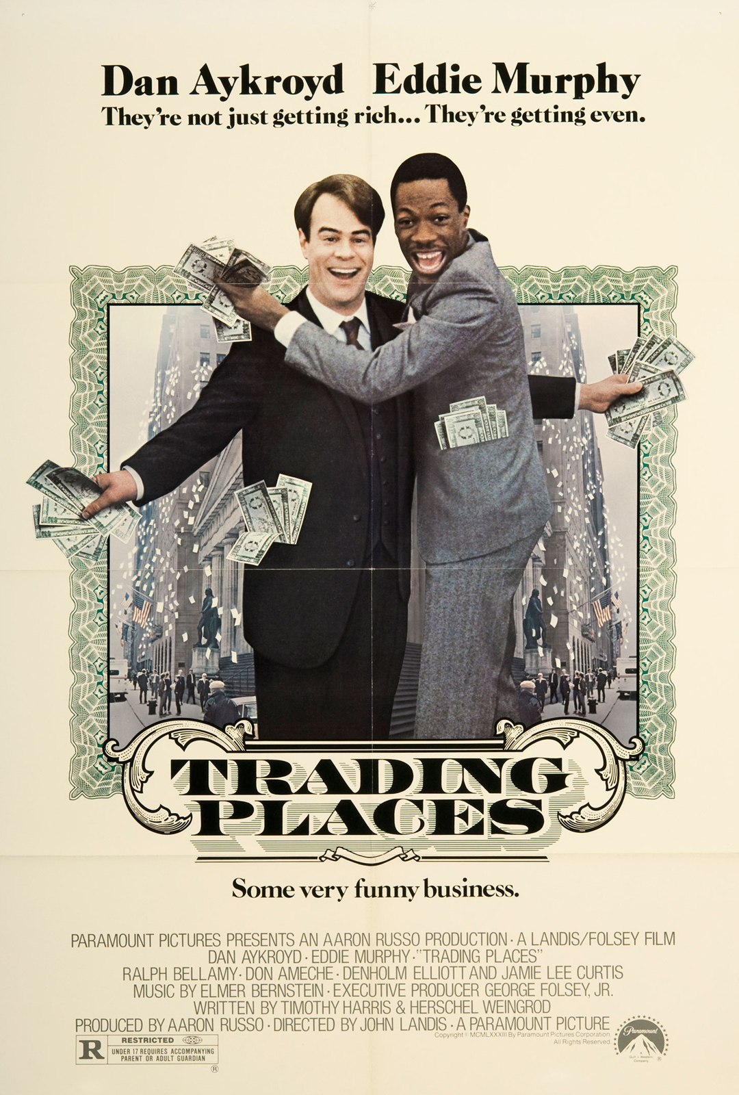
5. Stuff
Commodities: pork bellies, orange juice, coffee
Collectables: baseball cards, antique cars, stamps
Currencies: yen, yuan, euro
Precious metals: gold, silver
Historical annual return: who cares? Its not for you
R/B: Seriously, are you trying to lose money?

Slide 15
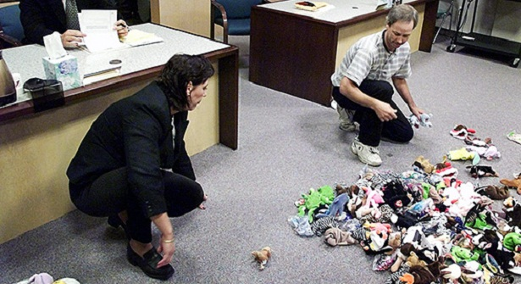
There are only two rules when it comes to investing. Rule #1: Don’t lose money. Rule #2. don’t forget rule #1.
- Warren Buffet

Slide 16
4 Asset classes
Stocks
Bonds
Real Estate
Cash
Stuff (everything else)
Big picture goal is to build a diversified portfolio with these 4 asset classes

Slide 17
How much cash do I need?
Emergency Fund: 3-6 months of expenses (not income)
Cover unexpected expenses: home repair, vehicle repair, medical leave, changing jobs
Depend on personal level of comfort
Remember that while there is no risk holding cash, there is also no return*
*you are losing money to inflation, so more than 6 mo cash is too much

Slide 18
Should I buy a house?
Spoiler alert: probably not
House price should not exceed 2-3x annual income
Monthly housing cost should not exceed 20% monthly income
Resident making 50K, house should not cost more than 150K
Rent/mortgage should not be more than 833/mo
Break even point is about 5 yrs
Real estate market rarely/never dips more than 20%
This is why the bank wants 20% down, even if you don’t pay another dime, they can foreclose your house and break even

Slide 19
Everyone loves math
Cost to sell a house is approximately 15% of price
Includes closing costs, staging costs, seller concessions, seller pays BOTH real estate agent commissions (6% of cost, 3% to each agent)
Costs you don’t have with rent are approximately 3%/yr
property tax, maintenance, home owner’s insurance, home owner/condo association fees, etc
6%/yr return - 3%/yr cost = 3% x 5 yrs = 15%
If you are in a 3 yr residency, you need 8%/yr to break even

Slide 20
“I love my job, I’ll be there forever…”
Sorry, you probably won’t
2/3 of ER physicians will change jobs within the first 2 years after residency
You probably won’t be working for your first employer most of your career
It makes sense to rent for a year, see how you like it before buying a house
In summary:
Buying a house is probably not for a doctor in a 3 yr residency (hint)
Buying a house is probably not for a doctor their first 2 yrs after residency (hint again)

Slide 21
Bonds
Bonds protect your portfolio from stock market swings
Your age should = percentage of portfolio dedicated to bond
Ie if you are: 25 yo = 25% bonds, 75% stocks
65 yo = 65% bonds, 35% stocks
Your portfolio gets more conservative as you age, tolerate less risk
Buy a bond index fund
You don’t know about corporate vs municipal vs junk vs treasuries, etc

Slide 22
stocks
Buying individual stocks is not a good idea for most investors
If you choose to ignore me, you need approximately 20 stocks
Fewer holdings are inadequate to diversify away non-systematic risk
More holdings dilute the percentage of “good” companies you hold
Try keeping a stock pick journal for a year and see how you do
Buy an index fund like S&P 500 or total stock market
500 largest companies make up 70% of whole stock market
40-50% of earnings from international markets

Slide 23
So you think you can pick winners…
80% of actively managed funds underperform the SP500 index

Slide 24
Model portfolios
Bogle: 65% US total stock index 35% US total bond index
Buffet: 90% SP500 index 10% cash
Olsen: 33% US total stock, 33% international stock, 33% US bond
McCormick: 50% Target date fund, 25% SP500 index, 15% individual stocks, 10% roboadvisor
Janowicz: 40% US Index, 5% Int’l Index,12% Int’l Stock, 35% US Stock,
5% Target Fund, 3% Bond

Slide 25
Target date fund
A fund of funds
Usually a mix of stocks and bond indices that get more bond heavy (conservative) as the target date approaches
Simplicity of holding a single fund
Ie Target 2040
65% Total US Stock index, 25% international stock index, 10% total US bond

Slide 26
Roboadvisors
Asset allocation determined by algorithms using age and risk tolerance
Simplicity of having a single account
Cheaper than human financial advisor
Ie “Aggressive” strategy
50% US stock, 40% international stock, 5% US bonds, 5% international bonds

Slide 27
Expense ratios
US stock market index funds 0.05%
US bond market index funds 0.10%
Target date fund 0.15%
Robadvisor 0.25%
Financial Advisor 1%

Slide 28
ROTH IRA (Individual retirement account)
Named after Delaware senator William Roth
Income limit $120,000 single or $189,000 married
Double tax advantaged: contribute post tax dollars
No tax on earnings or distributions
Contributions can be taken out without penalty at anytime
Earnings taken out before age 59 ½ are subject to penalty
Act as an “emergency fund”

Slide 29
“Back door” roth ira
Attendings make too much money to contribute directly
Anyone can contribute to a traditional IRA
Anyone can convert their traditional IRA to a ROTH IRA
Conversion amount does not exceed maximum ($5500)
Balance in all IRA accounts (traditional, SEP, Roth, SIMPLE, etc) = 0
If not, you will be subject to “pro rata” rule which is usually not tax efficient
Totally legal despite shady name
Almost any broker that allows for IRAs will have an easy process

Slide 30
Prioritize
Pay off any high interest credit card debt (10%+)
Save up an emergency fund
If you are a resident use a Roth IRA (contributions can be withdrawn penalty free)
Max out your retirement accounts
401K, especially if there is a match
HSA, it is the only triple taxed advantaged account that exists
Roth or backdoor Roth IRA
Pay down your student debt: guaranteed returns
0-3% probably better return in other investments
4-6% dealers choice
7%+ pay it down for sure
Taxable investment account using mix of stock/bond index funds

Slide 31
Financial advisors
SEC allows anyone to call self a financial advisor, analyst, consultant, planner
Many advisors are commissioned salesman in disguise
No one cares more about your money than you do
“Where are all the customers’ yachts?” – Fred Schwed

Slide 32
Conflicts of interest
Commission based: paid on how many financial products they sell, you
Highest commission are generally the worst products
AUM (Assets Under Management): percentage of investments usually 1%
They won’t advise you to pay off your student loan debt, mortgage
Retainer: paid a monthly/yearly fee, usually 1000-5000/yr
They want to spend as little time as possible with you
Hourly: Hourly fee, usually 200-500/hr
They want to spend as much time as possible with you

Slide 33
Is it hopcat time yet?
Want
a fiduciary: legal obligation to put your interests before their own
CFP (Certified Financial Planner) or CFA (Chartered Financial Analyst)
CPA + PFS: Certified Public Acountant Personal Financial Specialist
Fee Only
NAPFA.org: National Association Personal Financial Advisors
Don’t Want
A salesman/insurance agent
A “planner,” “advisor,” “consultant”
Commissioned based
Fee based = some fee + some commission = commission

Slide 34
Nope he’s still talking
Stocks: Index funds
Bonds: Age in percent also index funds
Real Estate: Buy a house less than 3x salary if you are planning on staying 5 yrs+
Cash: 3-6 mo expenses emergency fund/Roth
Stuff: just say no

Slide 35
How much is enough?
Trinity study -> 4% withdrawal rule
Estimate how much you need for retirement 25x expenses

Slide 36
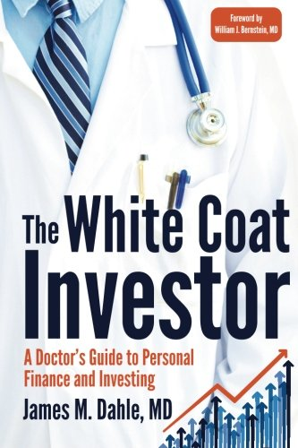
Best book for residents
Great place to start for basics
Book, podcast, blog
ER physician out of Utah

Slide 37
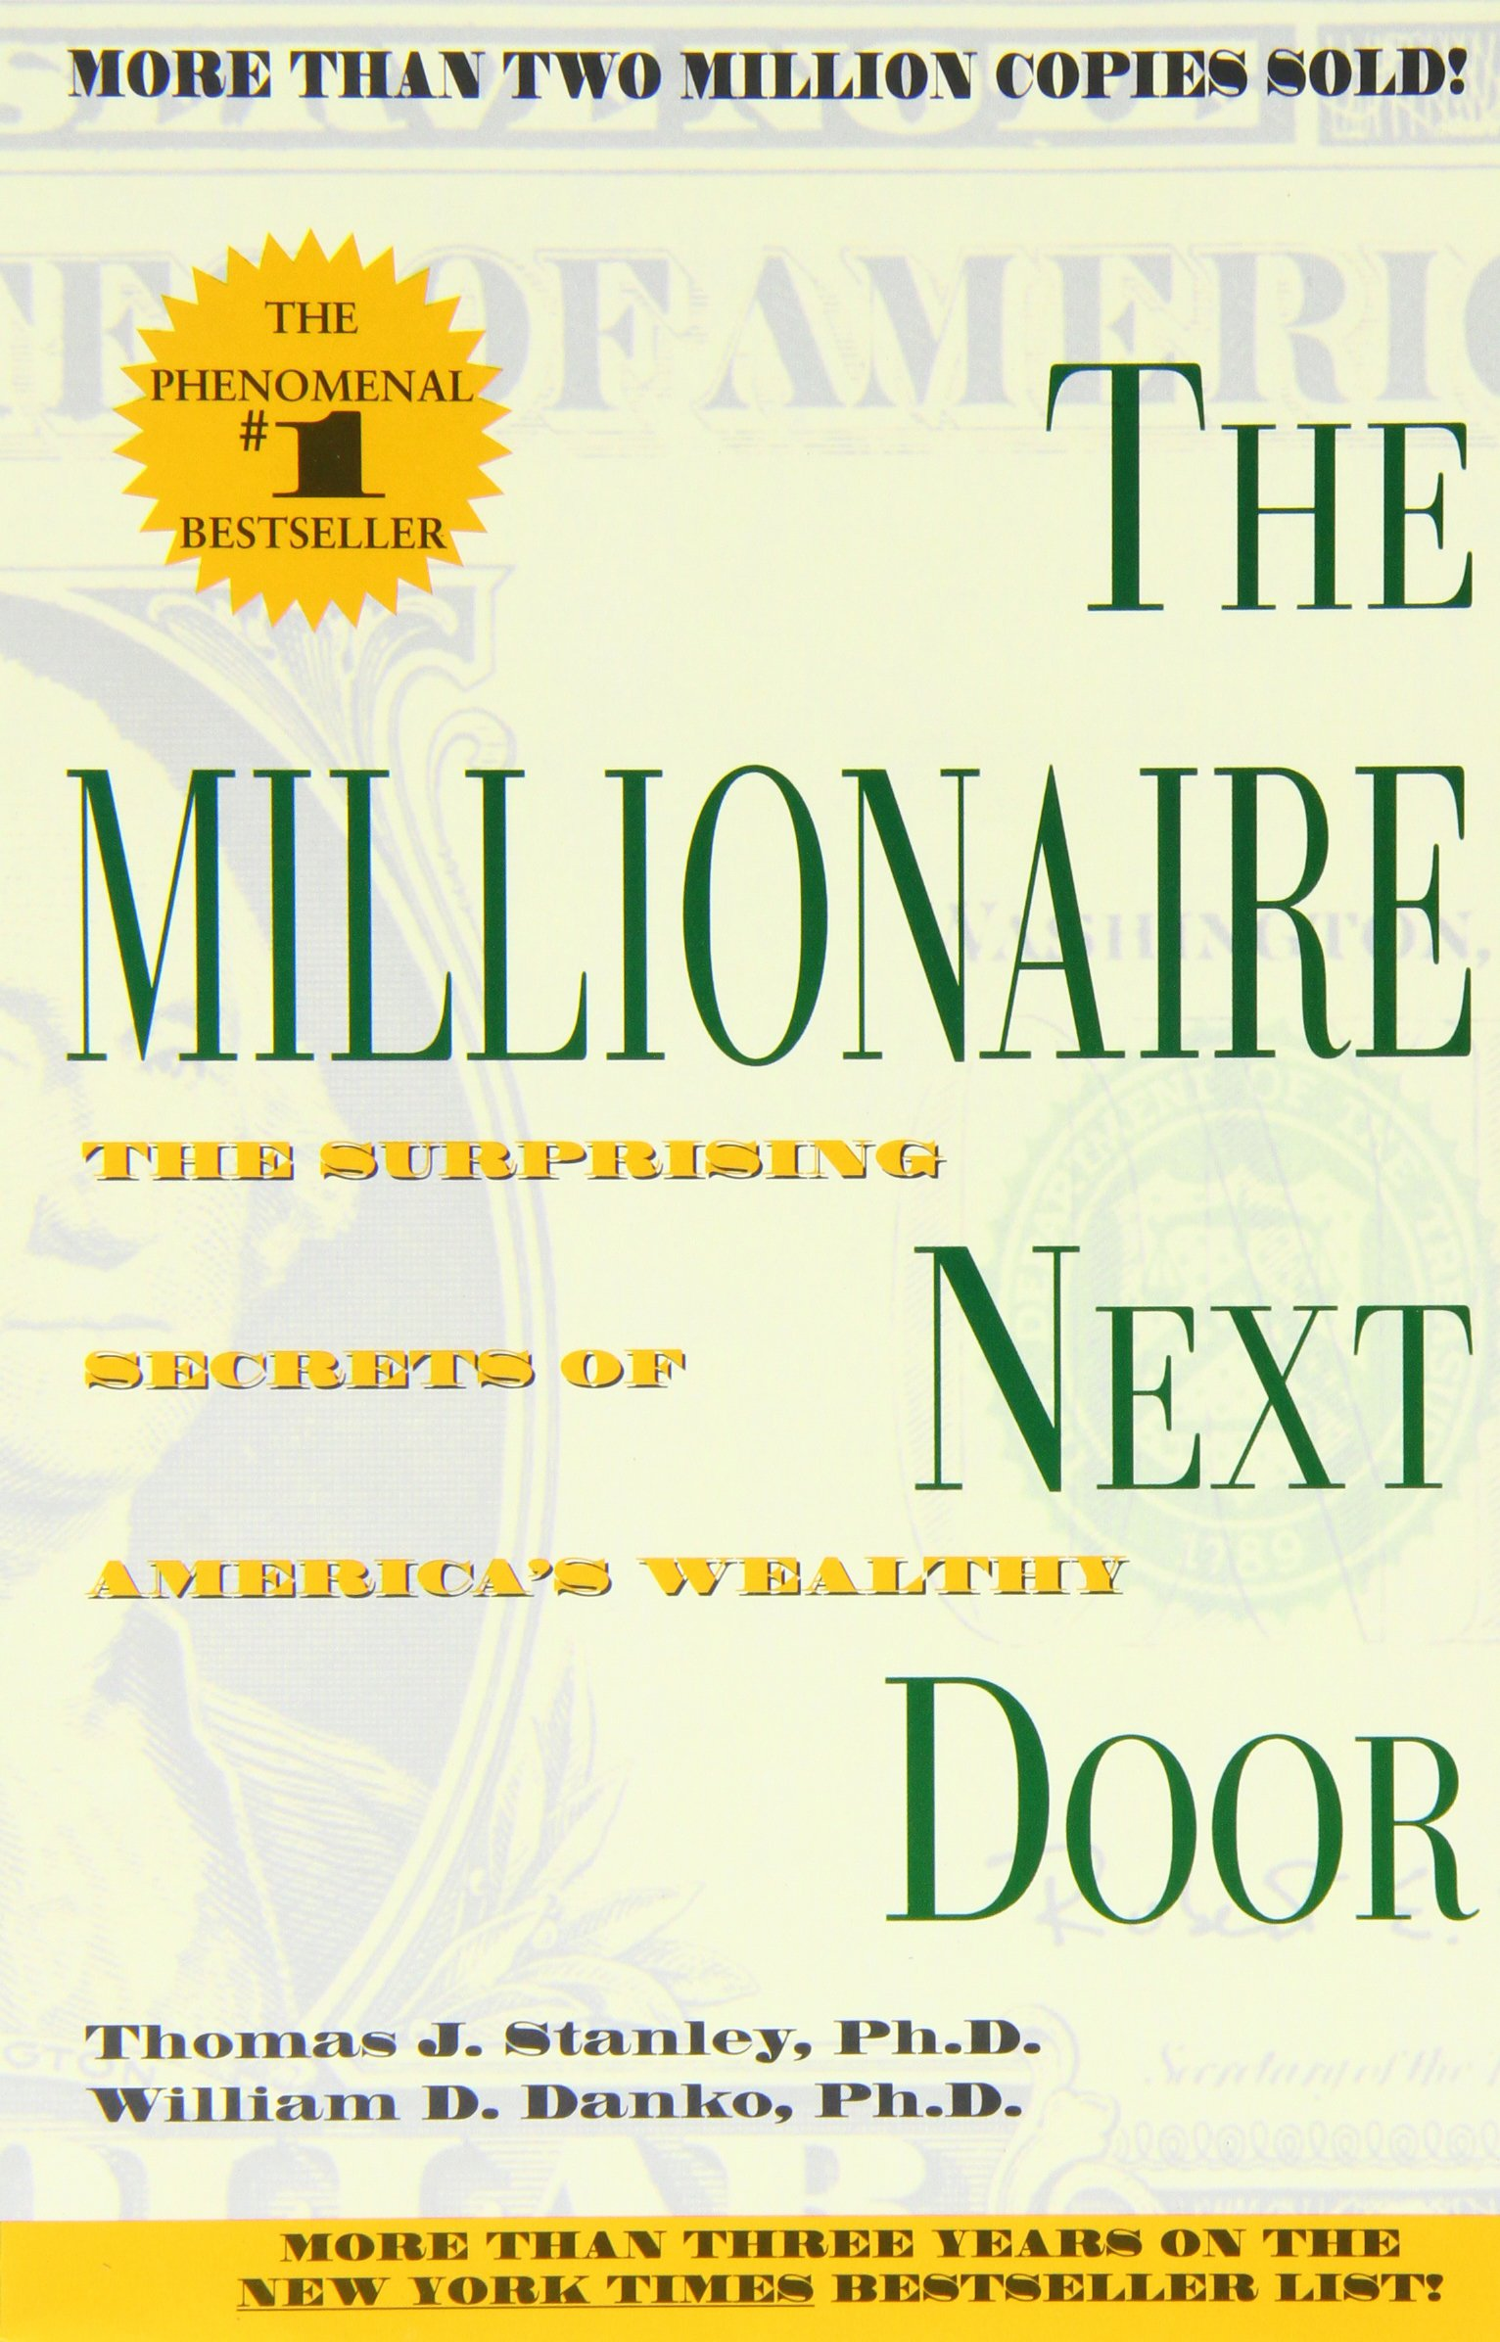
Best book for new attendings
Two Business School professors in NY
Interview people with net worth 1 million+
Used a surgeon with salary of 600,000 and net worth of 800,000 toward end of career as example of what not to do

Slide 38
Acknowledgements
Scott Freeman to introducing me to personal finance
Erik Olsen and Jeff Janowicz for being my financial (and clinical) mentors

Slide 39
Money frees you from doing things you dislike. Since I dislike doing nearly everything, money is handy
-Groucho Marx

Slide 40
Resources
SeanTeshimaMcCormick@gmail.com
whitecoatinvestor.com
The White Coat Investor – Jim Dahle
The Millionaire Next Door – Stanley and Danko
Money Masters – John Train
Simple Path to Wealth – Jim Collins
Intelligent Investor – Benjamin Graham
Stocks for the Long Run – Jeremy Siegel
WSJ Guide to Personal Finance – Ken Morris
Family Inc – Douglas McCormick
Money: Master the Game – Tony Robbins

